Slide 1


Facility Management
Performance Report
Executive Summary Overview
28,7%
degli impianti con guasto ha avuto interventi ripetuti nel 2025
52%
di tutti gli ODL dell'anno generato da questo sottoinsieme
PRESENTED BY
[Your Name Here]

Slide 2
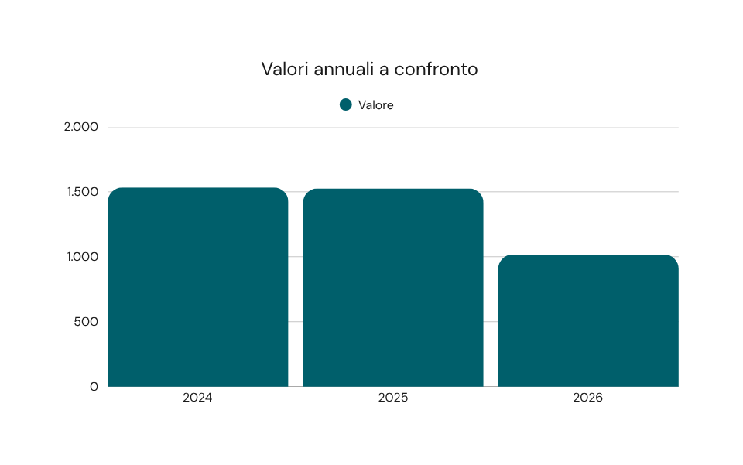
KPI Performance
  Confronto ODL totali 2024-2025-2026
  Trend in lieve calo su tre anni consecutivi
  Filiale Firenze: 72,7% impianti con guasti
  Sede Brescia: 64,6% impianti con guasti
  Hub Logistico Bologna: 30,5% con incidenza più bassa
ODL TOTALI PER ANNO

Slide 3
Performance Analysis
PROBLEMATIC BUILDINGS
Nel 2025, le sedi di Padova, Brescia e Torre Nord Milano hanno registrato il maggior numero di interventi ripetuti, evidenziando la necessità di una manutenzione mirata.
RECIDIVISMO DEGLI IMPIANTI
Alcuni impianti hanno generato fino a 8 interventi nello stesso anno, dimostrando che una gestione efficiente è cruciale per evitare carichi ricorrenti sulle squadre tecniche.

Slide 4
Key Issues and Root Causes
MAINTENANCE LOAD IMBALANCE
CONCENTRATED ASSET FAILURES
AGING INFRASTRUCTURE CONCERNS
The maintenance load is unevenly distributed across the asset portfolio, causing specific assets to require disproportionate attention and resources, thereby straining the technical teams.
A small group of assets generates a significant share of interventions, revealing critical underlying problems that are not yet fully diagnosed or resolved, leading to repeated issues.
Localized aging and recurring corrective maintenance rather than resolving issues contribute to ongoing challenges, which, if unaddressed, will continue to burden the technical teams with recurring loads.

Slide 5
Recommended Actions
PRIORITIZE INSPECTION
EVALUATE REPLACEMENT
Conduct thorough inspections on assets identified as recurrent issues in 2025 to ensure early detection and prevention of further malfunctions and service interruptions.
Assess the need for replacement or extraordinary maintenance for assets that have incurred more than five interventions within the year, addressing underlying problems effectively.
AUTOMATE REPORTING
QUARTERLY REVIEW
Implement monthly automated report generation for continuous monitoring, minimizing manual intervention and enabling timely responses to emerging issues within the facility management system.
Conduct quarterly reviews of the list of recidivist plants to identify new patterns and trends promptly, ensuring proactive strategies are employed for effective facility management.

